Slide 1
Cohort risk sharing in Pakistan: relative wage and consumption movements
Dr. Syed Hassan Raza
Assistant Professor of Economics
Quaid-i-Azam University
Dr. Raza is an applied economist with research interests in the fields of health, development and macroeconomics. This presentation belongs to one of his papers published in Journal of Applied Economics and Business Studies in March 2020.

Slide 2
Motivation
“Pakistan is one of the Next Eleven countries that have potential to be among largest economies of 21st century”
What is the degree of consumption risk sharing in Pakistan? Moreover, it is important to check, to which extent the distribution of consumption is affected by the relative wage movement among the birth cohorts and education groups ?
Another important factor is to adopt the well known and unique methodology developed by Attanasio and Davis (1996). Key advantages of this methodology includes, focus on systematic and publicly observable relative wage movement, and observationally distinct groups enables the use of cross sectional data.
In comparison to Attanasio and Davis (1996) I have evaluated the degree of consumption risk sharing over 6, 8 and 10 year horizons. In short, it tells us how the slope evolves over time or to which extent people are smoothing the consumption as we move from short to long duration.

Slide 3
Key findings
Striking evidence against consumption smoothing in shorter duration like over 6 and 8 years growth in consumption and income.
Unlike the findings of Attanasio and Davis (1996) we conclude slope revolves around 1 in shorter duration like in six years growth specification.
Income shocks insignificantly affects the consumption, specially in longer duration, in particular to ten years growth specification. We documented the magnitude of slope is 0.257 with SE of 0.177.
Consumption of younger cohorts are more susceptible to income shocks in comparison to older cohorts. But in some of the cases we observed highly educated people are priced similar to less educated people.
There is greater variation in consumption for people with junior middle education in contrast to the people having intermediate or university education.

Slide 4
A SNAPSHOT OF EXISTING LITERATURE
There is an escalating amount of literature which documented the relative wage movement and consumption smoothing through various perspectives. Major contributions are accredited to developed countries due to better tracking and availability of datasets. However, in empirical research it remains underdeveloped area for developing economies.
Cochrane, (1991) was first to test whether consumer are insured against idiosyncratic shocks to income and wealth. Townsend, (1994) further implemented the full insurance model on three Indian villages. He concluded household consumption is not influenced by idiosyncratic shocks, unemployment or income.
Attanasio and Davis, (1996) implemented the test of Cochrane (1991) by exploited the basic assumption maintain in his paper. They built the synthetic panel by using data on US labor supply, consumption and wages in 1980 and documented the spectacular failure of consumption insurance hypothesis.
Attanasio and Szekely, (2004) investigated the high volatility period in Mexico on similar research question. They presented the evidence of relationship between relative male wage and growth in consumption.

Slide 5
A SNAPSHOT OF EXISTING LITERATURE
Krueger and Perri., (2006) used consumer expenditure survey and document despite of noteworthy increase in both, between and within group of household income inequality in United Stated, there is moderate increase in consumption inequality.
Blundell et al., (2008) in their work analyzed the extent to which consumption is insured against income shocks. They combined two different panel datasets to observe the transmission of inequality from income to consumption. Study concludes that the people in US offset transitory shocks by greater insurance arrangements, whereas the degree of insurance varies across the demographic groups.
Heathcote, Perri and Violante, (2010) ) used four different surveys to document cross sectional inequality in United States. They measured the different dimensions of inequality through market, choices and institution. Findings reveal reasonable increase in income inequality, whereas, taxes and transfers compress the inequality especially at the bottom of income distribution. Study concludes with the evidence that changes in distribution of hours worked generates income inequality.
Santaeulalia and Yu, (2018) estimated consumption risk sharing in developed and developing countries. They found over long run consumption risk is better in developing countries in comparison to developed countries.

Slide 6
Data Source AND SAMPLE SELECTION
Household integrated income survey of Pakistan (HIES) has been conducted with some breaks since 1963. However, the survey was renamed as “Pakistan Social and Living Standard Measurement (PSLM) Survey” in 2004, and basic module of HIES remained intact. Since 2004, the survey is conducted in every alternate year. It’s a repeated cross sectional survey data which covers detailed information on consumption, education, income and employment.
Prime Age Working Male Heads
Have work at least 20 days a month and 10 months a year
Considered those who have completed the education
OECD scales are used to construct adult equalized consumption.
Possibility of outliers in the data have been removed by dropping the top and bottom 1% of the observations which makes the data ready to study relative wage movement and consumption distribution.

Slide 7
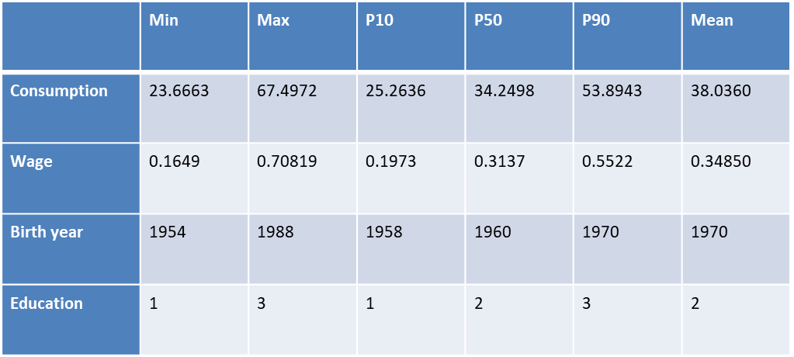
Summary statistics
Both consumption and wages are deflated to get the real values.

Slide 8
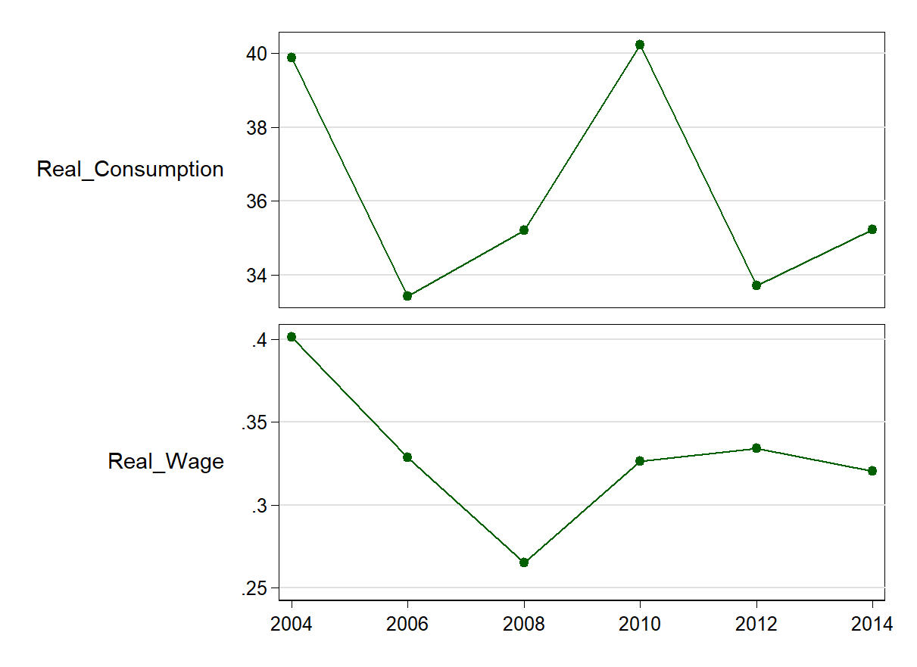
Cross sectional facts
Trend of Average Real Consumption and Real Wage
Source: Authors calculations

Slide 9
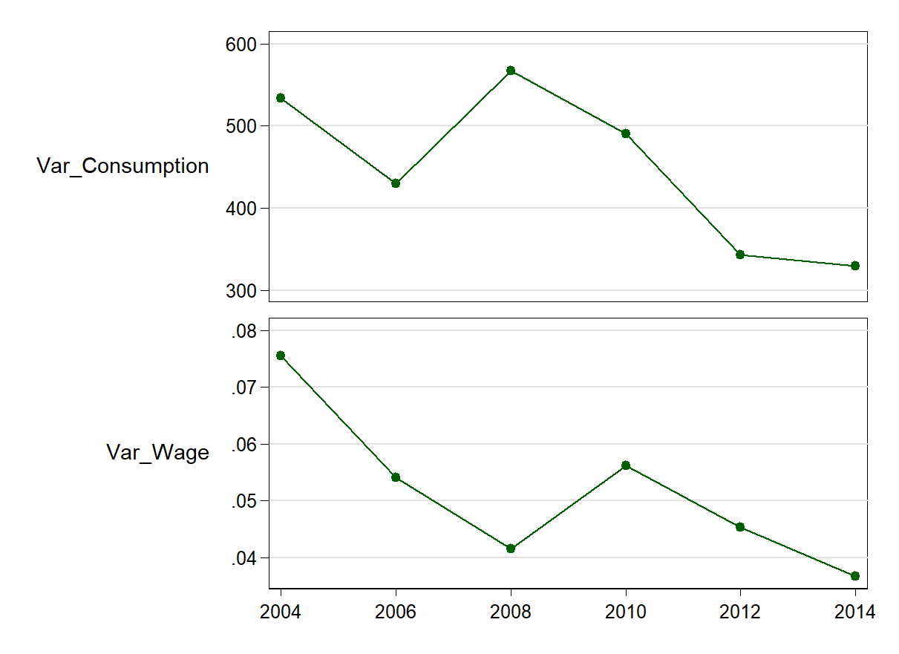
Cross sectional facts
Trend of Variance in Real Consumption and Hour Wage
Source: Authors calculations

Slide 10
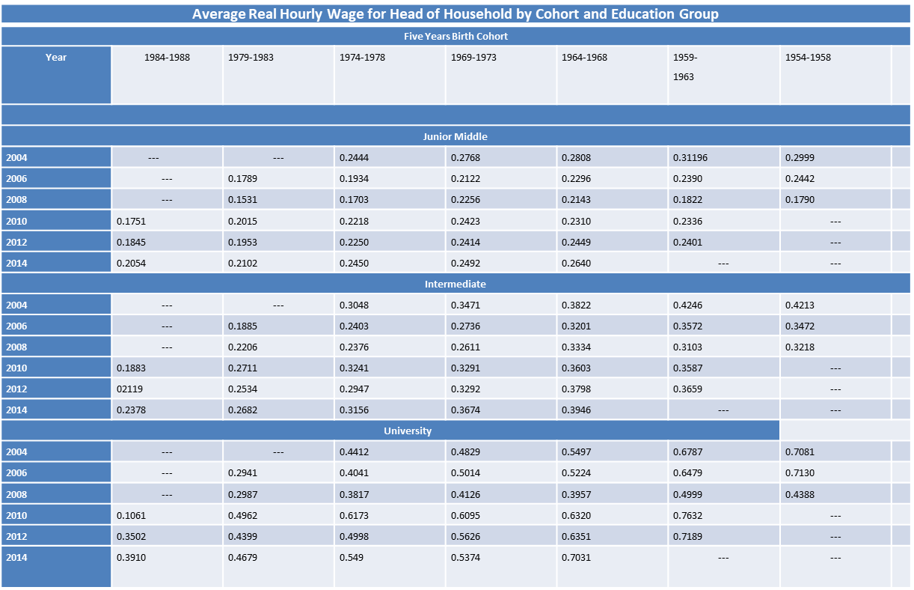

Slide 11
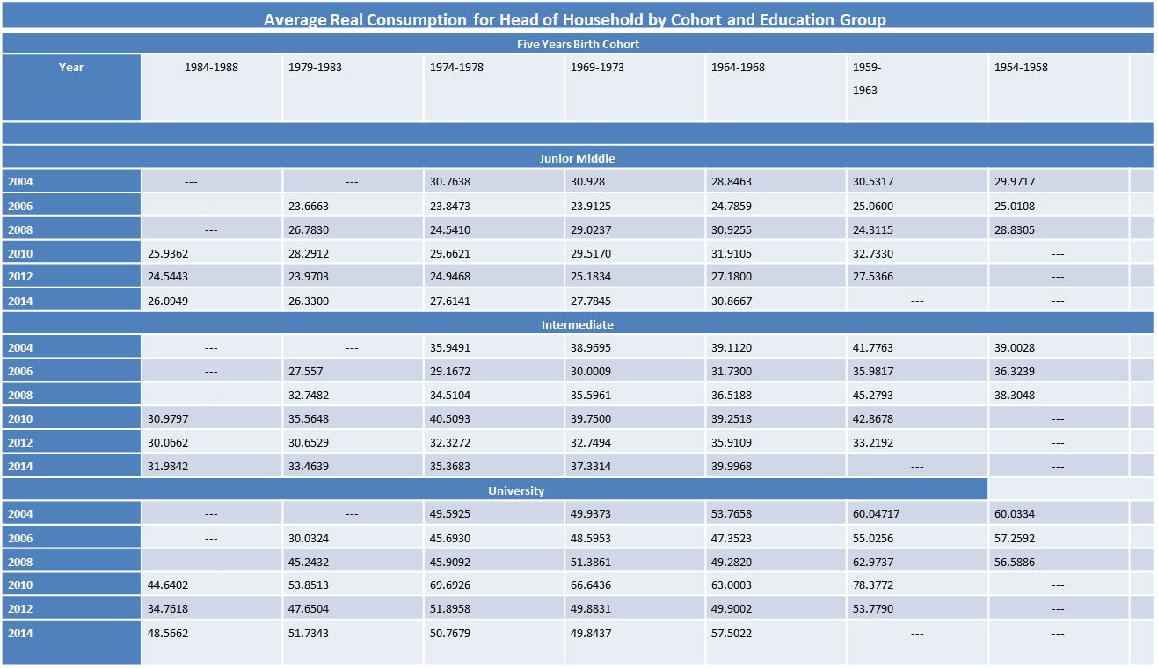

Slide 12
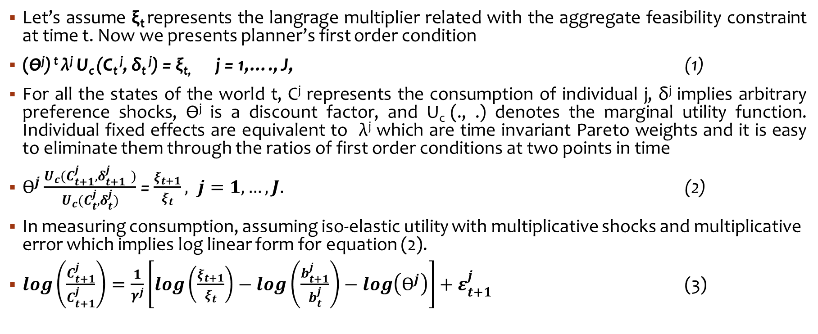
Theoretical foundations
Let’s assume ξ_{t} represents the langrage multiplier related with the aggregate feasibility constraint at time t. Now we presents planner’s first order condition
(Ѳ^{j}) ^{t} λ^{j} U_{c} (C_{t} ^{j}, δ_{t} ^{j}) = ξ_{t,} j = 1,…., J, (1)
For all the states of the world t, C^{j} represents the consumption of individual j, δ^{j} implies arbitrary preference shocks, Ѳ^{j} is a discount factor, and U_{c} (., .) denotes the marginal utility function. Individual fixed effects are equivalent to λ^{j} which are time invariant Pareto weights and it is easy to eliminate them through the ratios of first order conditions at two points in time
$Ѳ^{j}\frac{U_{c}(C_{t+1}^{j}, δ_{t+1 }^{j})}{U_{c}(C_{t}^{j},δ_{t}^{j})}$ = $\frac{ξ_{t+1}}{ξ_{t}}, j=1,…,J.$ (2)
In measuring consumption, assuming iso-elastic utility with multiplicative shocks and multiplicative error which implies log linear form for equation (2).
$log\left(\frac{C_{t+1}^{j}}{C_{t+1}^{j}}\right)=\frac{1}{γ^{j}}\left[log\left(\frac{ξ_{t+1}}{ξ_{t}}\right)−log\left(\frac{b_{t+1}^{j}}{b_{t}^{j}}\right)−log\left(Ѳ^{j}\right)\right]+ε_{t+1}^{j}$ (3)

Slide 13
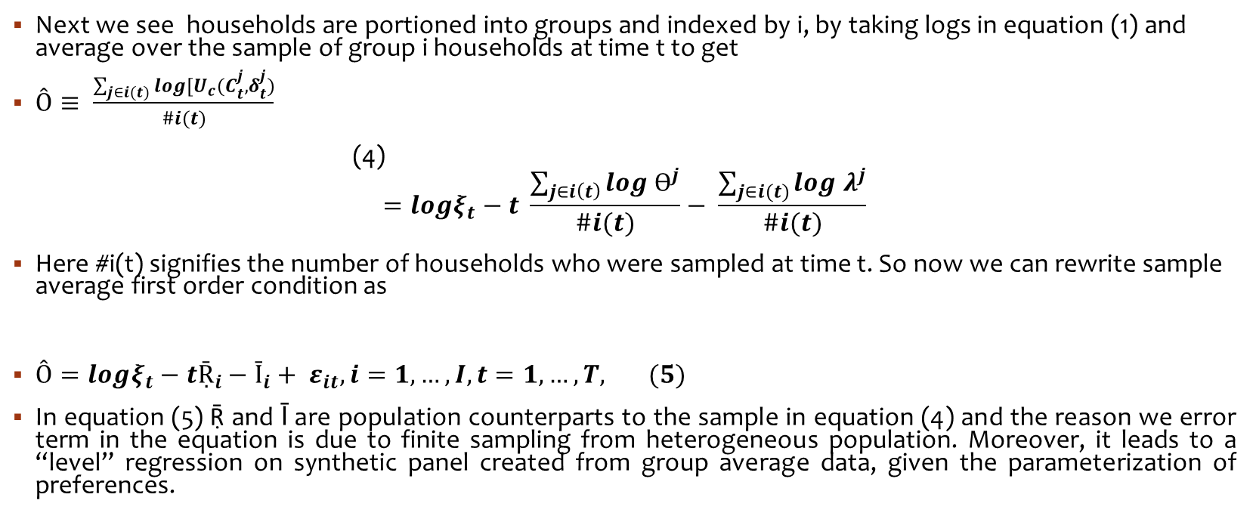
Theoretical foundations
Next we see households are portioned into groups and indexed by i, by taking logs in equation (1) and average over the sample of group i households at time t to get
$Ô≡ \frac{\sum_{j∈i(t)}{log[U_{c}(C_{t}^{j}, δ_{t}^{j})}}{\#i(t)}$ (4)
$$=logξ_{t}−t \frac{\sum_{j∈i\left(t\right)}{log Ѳ^{j}}}{\#i(t)}− \frac{\sum_{j∈i(t)}{log λ^{j}}}{\#i(t)}$$
Here #i(t) signifies the number of households who were sampled at time t. So now we can rewrite sample average first order condition as
$Ô=logξ_{t}−tṜ_{i}−Ῑ_{i}+ ε_{it}, i=1,…,I,t=1,…,T, (5)$
In equation (5) Ṝ and Ῑ are population counterparts to the sample in equation (4) and the reason we error term in the equation is due to finite sampling from heterogeneous population. Moreover, it leads to a “level” regression on synthetic panel created from group average data, given the parameterization of preferences.

Slide 14
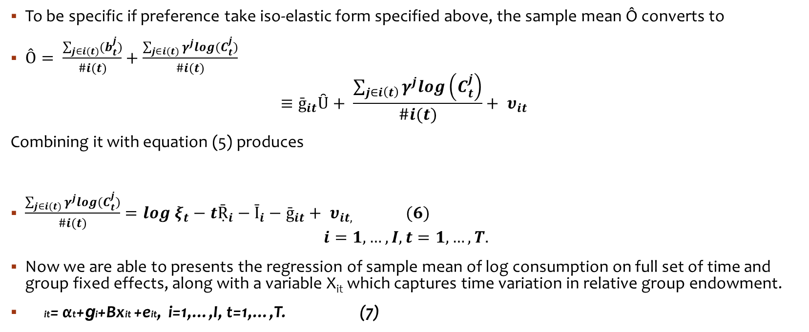
Theoretical foundations
To be specific if preference take iso-elastic form specified above, the sample mean Ô converts to
$Ô= \frac{\sum_{j∈i(t)}{(b_{t}^{j}})}{\#i(t)}+\frac{\sum_{j∈i(t)}{γ^{j}log(C_{t}^{j})}}{\#i(t)}$
$$≡ḡ_{it}Ȗ+ \frac{\sum_{j∈i\left(t\right)}{γ^{j}log\left(C_{t}^{j}\right)}}{\#i(t)}+ υ_{it}$$
Combining it with equation (5) produces
$\frac{\sum_{j∈i(t)}{γ^{j}log(C_{t}^{j})}}{\#i(t)}=log ξ_{t}−tṜ_{i}−Ῑ_{i}−ḡ_{it}+ υ_{it, } (6)$
$$i=1,…,I, t=1,…,T.$$
Now we are able to presents the regression of sample mean of log consumption on full set of time and group fixed effects, along with a variable X_{it} which captures time variation in relative group endowment.
it= αt+ɡi+Βxit +eit, i=1,…,I, t=1,…,T. (7)

Slide 15
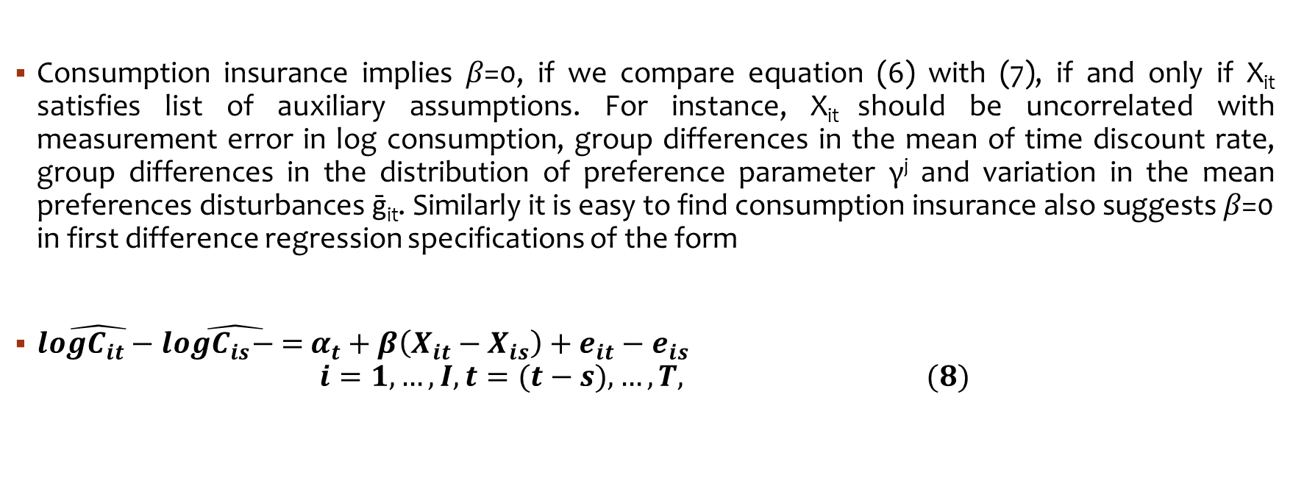
Theoretical foundations
Consumption insurance implies 𝛽=0, if we compare equation (6) with (7), if and only if X_{it} satisfies list of auxiliary assumptions. For instance, X_{it} should be uncorrelated with measurement error in log consumption, group differences in the mean of time discount rate, group differences in the distribution of preference parameter γ^{j} and variation in the mean preferences disturbances ḡ_{it}. Similarly it is easy to find consumption insurance also suggests 𝛽=0 in first difference regression specifications of the form
$\hat{{logC}_{it}− }\hat{{logC}_{is}− = }α_{t}+β\left(X_{it}−X_{is}\right)+e_{it}−e_{is}$
$$i=1,…,I, t=(t−s),…,T, (8)$$

Slide 16

Empirical setting
$\log{dc= α_{1}}\left(age\right)+ α_{2}{\left(age\right)}^{2}+α_{3}{\left(age\right)}^{3}+α_{4}(hhsize)$
$e_{t}=\log{dc −\log{\hat{dc}}}$
$\log{dy=β_{1}}\left(age\right)+ β_{2}{\left(age\right)}^{2}+β_{3}{\left(age\right)}^{3}+β_{4}(hhsize)$
$ε_{t}=\log{dy −\log{\hat{dy}}}$
$e_{t}= γ(ε_{t})$

Slide 17
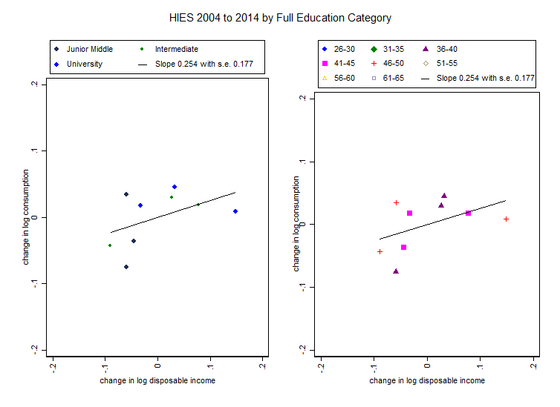
Results on risk sharing over 10 years

Slide 18
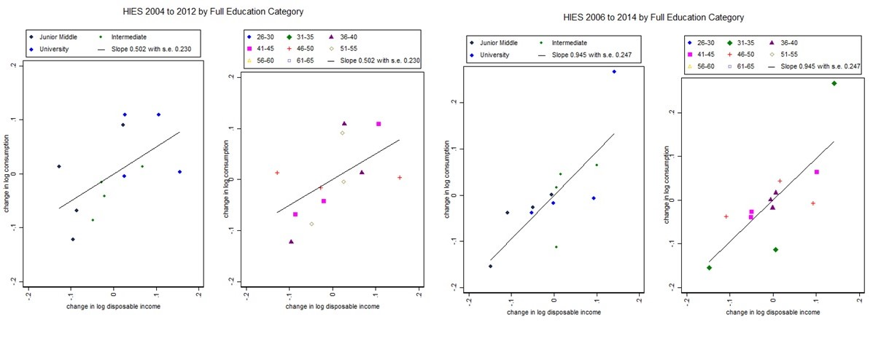
Results on risk sharing over 8 years

Slide 19
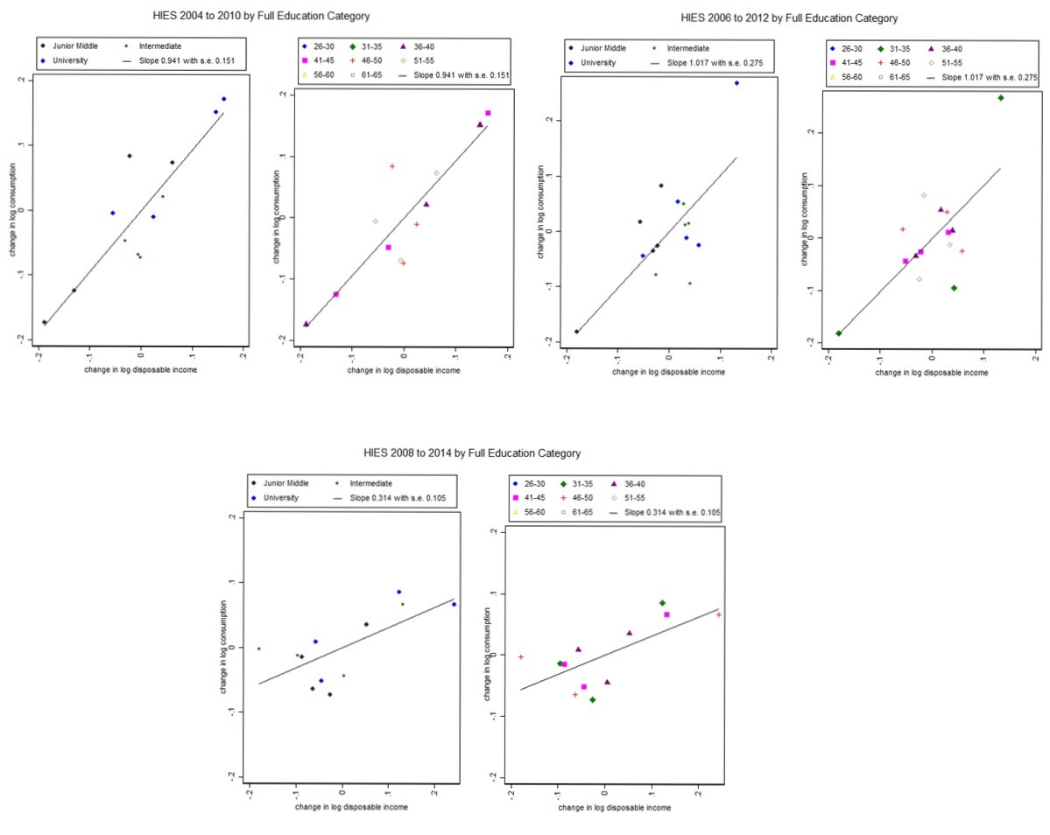
Results on risk sharing over 6 years

Slide 20
Results and discussion
Except ten years growth specification, we observe in majority of the cases that adult equalized consumption significantly commoves with hourly wage. Moreover, as we increase the time period for growth, we document the evidence of higher consumption smoothing. However, in lesser duration we document the evidence against consumption insurance hypothesis.
Interestingly we observe, there is a greater decline in hourly wage for people University or Junior middle education in 2008, however, there is lesser decline in hourly wage for people with Intermediate education. The reason behind decline in hour wage can not be addressed in this study. However, from 2008 to 2010 Pakistan faced a great decline in economic growth.
Evidence suggest negative growth in income for least educated people in the dataset. However, consumption is affected due to income but magnitude of co-movement is not equal as we can see in figures of 6 and 8 years growth specifications.

Slide 21
RECOMMENDATIONS
We started researching on this issue as we observed Pakistan’s economy underwent definite and persistent movements in the structure of relative wages since 2004. We outline that the relative wage movements across the birth cohorts and education groups bring noteworthy changes in distribution of adult equalized household consumption.
It is ideal to see risk and insurance from different spectrum as in the developing economies repeated cross section data is easily available than longitudinal panel due to higher tracking.
Moreover, different consumption bundles can be created to check the what sort of consumption is more susceptible to shocks and what is well insured. In this paper we have presented the benchmark results which gives us the idea about all the non-durable items whether purchased from market or self-produced.
These results raise some interesting questions about insurance mechanism in Pakistan which should be answered in order to formulate the effective policy. For instance regardless of decline in hourly wage in 2008, consumption remains smooth. Do people smooth more in the times of recession?

Slide 22
Thank you so much for listening to me
Full text of this paper is available at my research gate profile, google scholar profile and website of Journal of Applied Economics and Business Studies. For further questions please contact me at shraza@qau.edu.pk

